Slide 1
Using Aerosol Data to Find Evidence of Volcanic Activity

Slide 2
Objectives:
Analyze data to find evidence of volcanic activity
Analyze more than one data source for evidence of activity
Make a claim based on evidence of how aerosols and sulfur dioxide data are related
Share your findings with others

Slide 3
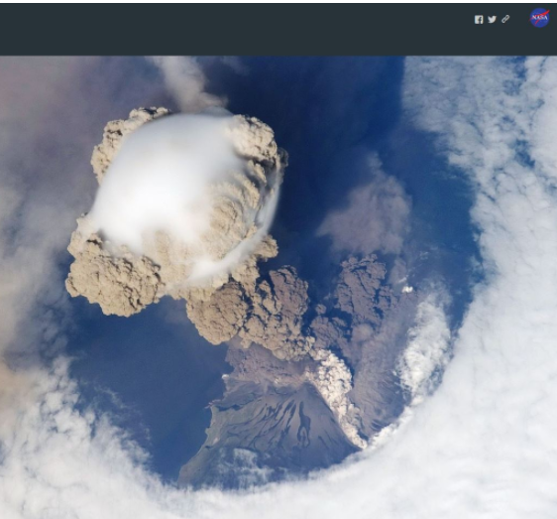
Essential Question:
How can satellite data be used to detect and monitor volcanic activity?

Slide 4
What do you know?
What are some of the effects of volcanic activity?
How are volcanoes found in the geosphere related to the atmosphere?
How can volcanoes be hazardous to living things in the atmosphere?

Slide 5
Class Discussion

Slide 6
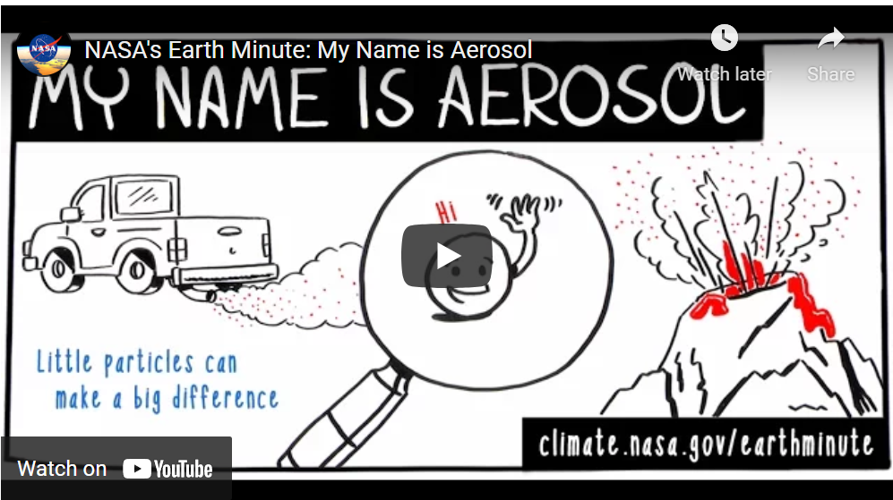
Build Background
My Name is Aerosol
Give examples of different sources of aerosols.
What are the effects of aerosols?
How does NASA study them?
Why does NASA study them?

Slide 7
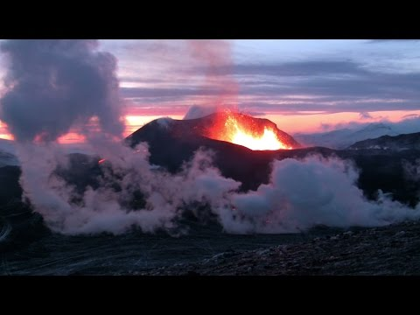
Begin Exploration
Let’s watch the NASA video: Fire, Ice, and Safer Skies: NASA Satellites Track Volcanic Clouds
What are some things you observed in the video?
What is a way in which satellites can help NASA scientists when observing sulfur dioxide?
How does this information help pilots?

Slide 8
Class Discussion
What data does NASA collect to better understand volcanic emissions?
How does NASA collect these data?
How do the data change over time?
How does this information help pilots?

Slide 9
If there are so many different sources of aerosols, how can we know that aerosols we are seeing in data are from a volcano?

Slide 10
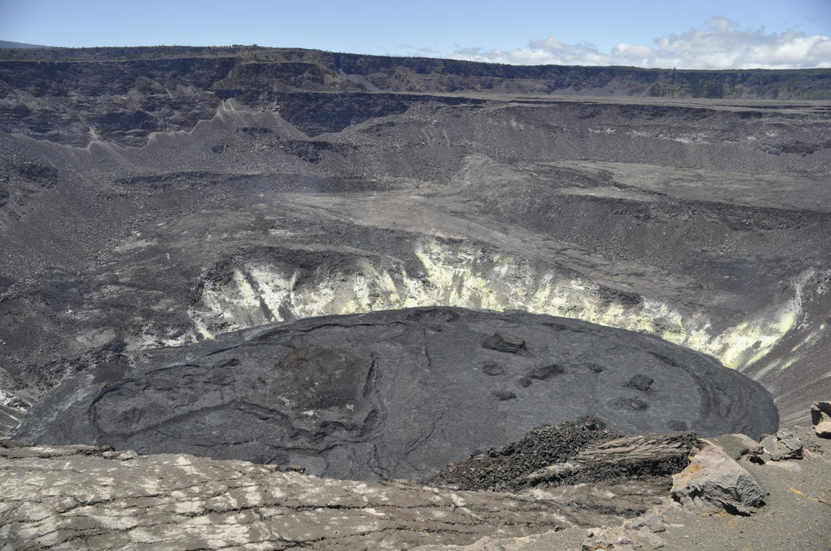
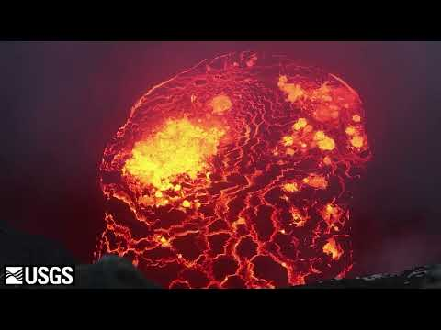
Welcome to Kilauea...
View of Halema‘uma‘u at Kīlauea summit - July 30, 2021

Slide 11
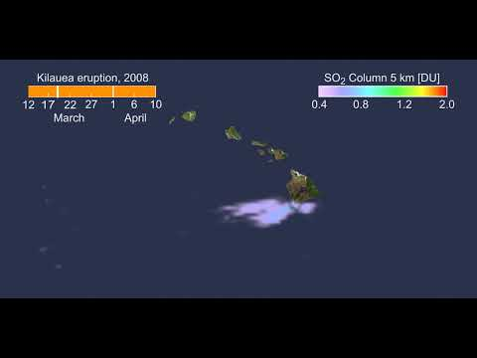
Analyze Data
You will work in groups to look at data obtained in the months around a major eruption of Kilauea in HI.
To get started, view the animation of sulfur dioxide from 2008 to observe how sulfur dioxide gas relates to volcanic eruptions.
Was there any noticeable change in the video? If so, when?
To what degree did the data values change?

Slide 12
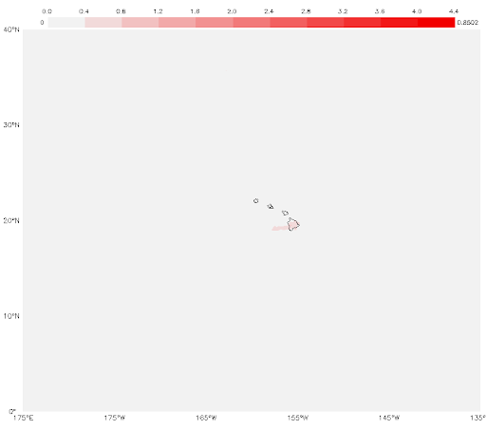
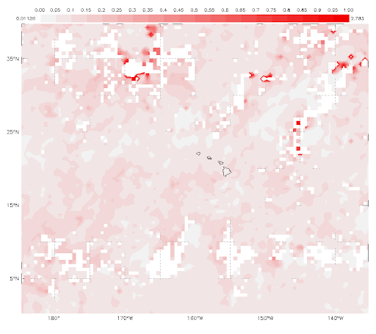
Digging Deeper
January 2018
Group A will view the monthly SO₂ images. Jamboard for Group A.
Group B will view the Monthly Aerosols. Jamboard for Group B.
Each group will sequence monthly mapped images for 2018 in chronological order and answer the following questions:
Monthly SO₂ Hawaii
Monthly Aerosols, Hawaii
How do the data change?
What is the rate of change in the data from month to month?
What patterns do you observe in the way that the data change over time?

Slide 13
Observation Tip
January 2018
Monthly SO₂ Hawaii
Monthly Aerosols, Hawaii
What do the white spots mean? This shade of white is not included in the color key, so what does it mean? The uncolored pixels indicate places where persistent cloud cover prevents the sensor from collecting observations and results in missing data in the data set.

Slide 14
January 2018
Monthly SO₂ Hawaii
Monthly Aerosols, Hawaii

Slide 15
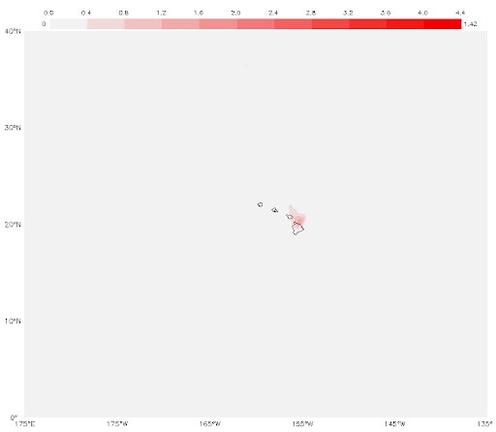
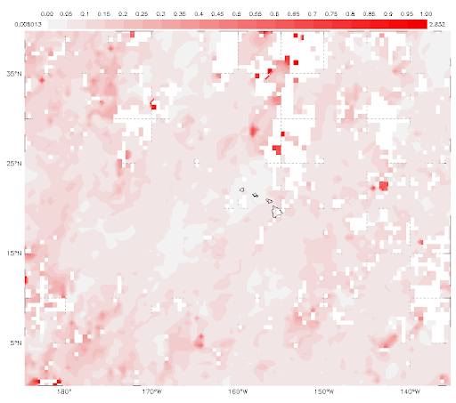
February 2018
Monthly SO₂ Hawaii
Monthly Aerosols, Hawaii

Slide 16
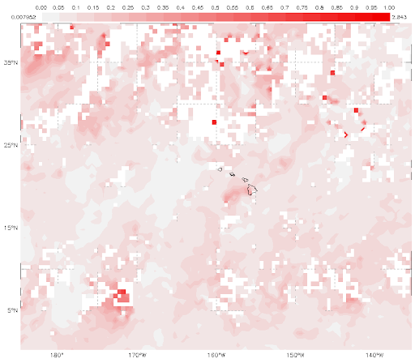
March 2018
Monthly SO₂ Hawaii
Monthly Aerosols, Hawaii

Slide 17
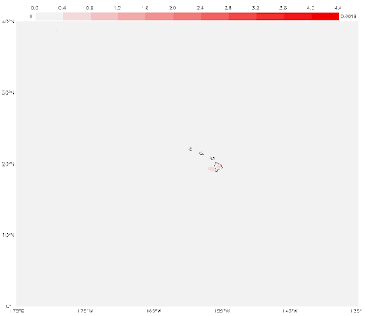
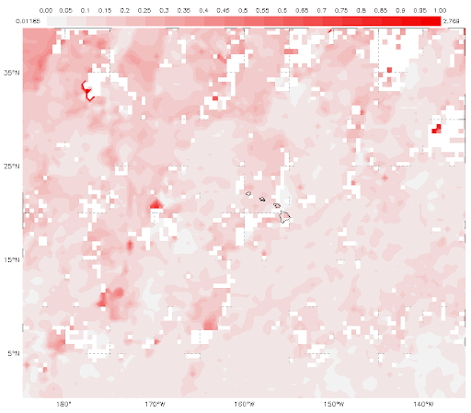
April 2018
Monthly SO₂ Hawaii
Monthly Aerosols, Hawaii

Slide 18
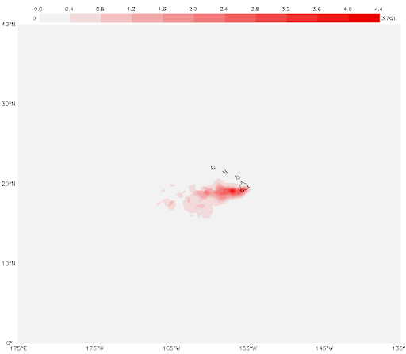
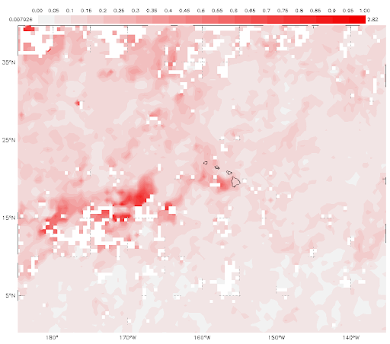
May 2018
Monthly SO₂ Hawaii
Monthly Aerosols, Hawaii

Slide 19
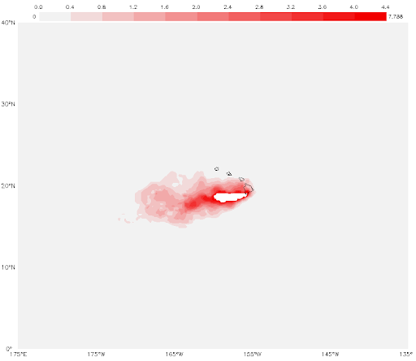
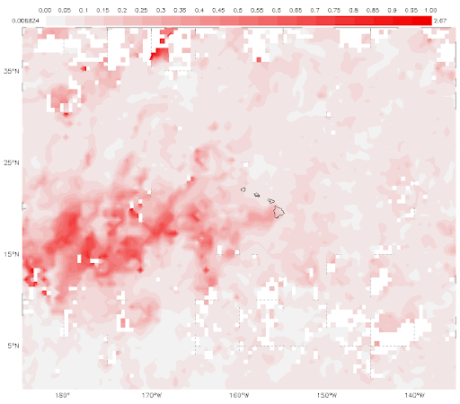
June 2018
Monthly SO₂ Hawaii
Monthly Aerosols, Hawaii

Slide 20
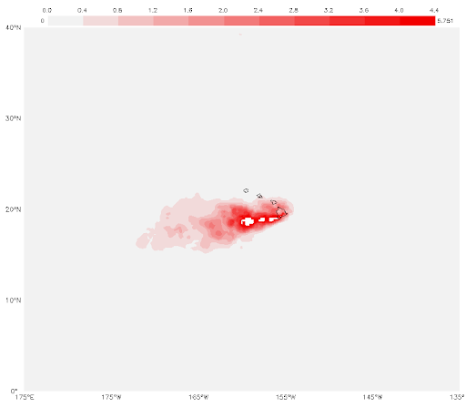
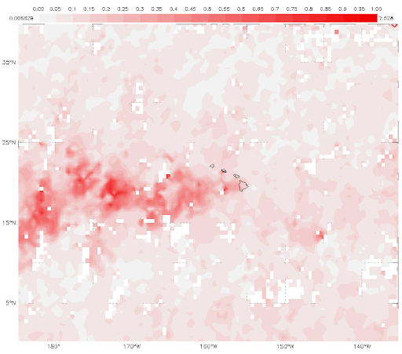
July 2018
Monthly SO₂ Hawaii
Monthly Aerosols, Hawaii

Slide 21
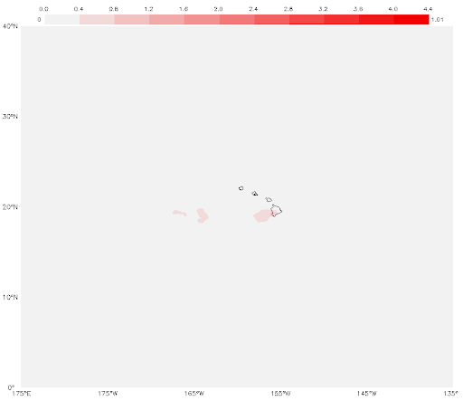
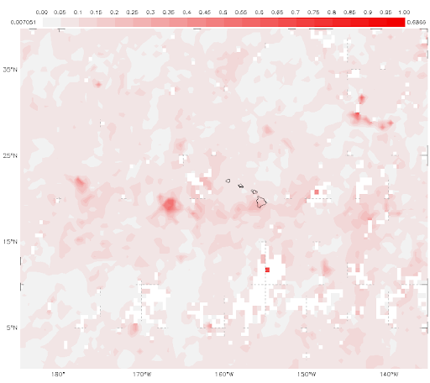
August 2018
Monthly SO₂ Hawaii
Monthly Aerosols, Hawaii

Slide 22
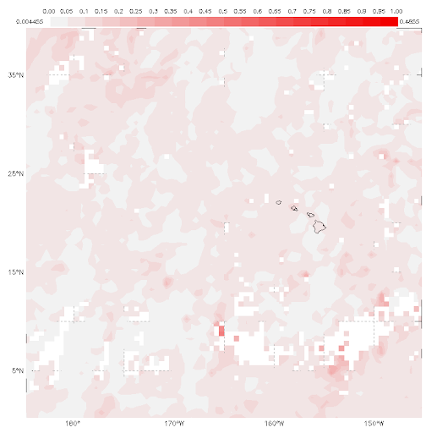
September 2018
Monthly SO₂ Hawaii
Monthly Aerosols, Hawaii

Slide 23
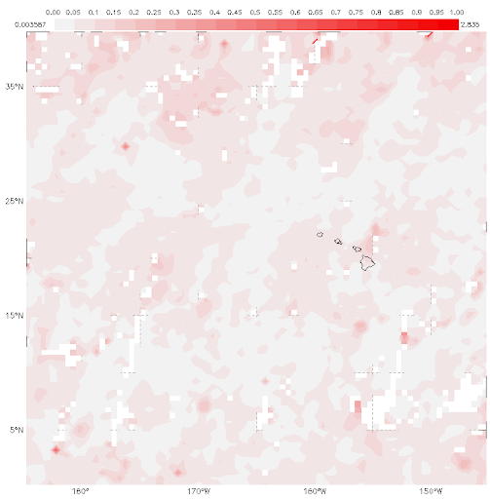
October 2018
Monthly SO₂ Hawaii
Monthly Aerosols, Hawaii

Slide 24
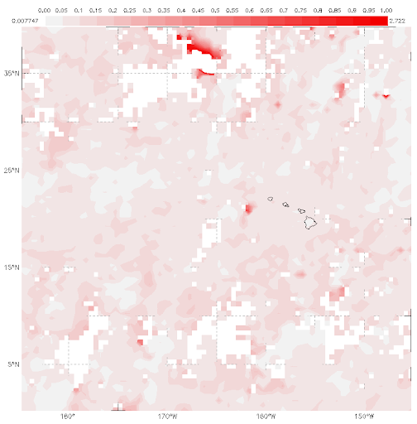
November 2018
Monthly SO₂ Hawaii
Monthly Aerosols, Hawaii

Slide 25
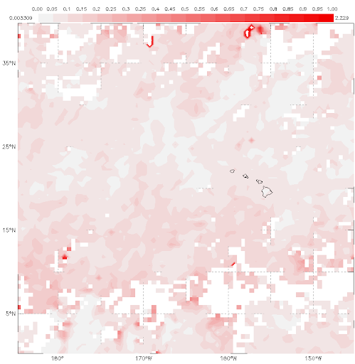
December 2018
Monthly SO₂ Hawaii
Monthly Aerosols, Hawaii

Slide 26
Analyze the 10 year graph of your science variable. Compare the graph with the images and answer the questions below.
Does this graph agree with the images for the same variable?
What was the trend over the course of a year? decade?
Was there any noticeable change? What might have caused this?
How is the rate of change changing over time? Is this to be expected in the future?

Slide 27
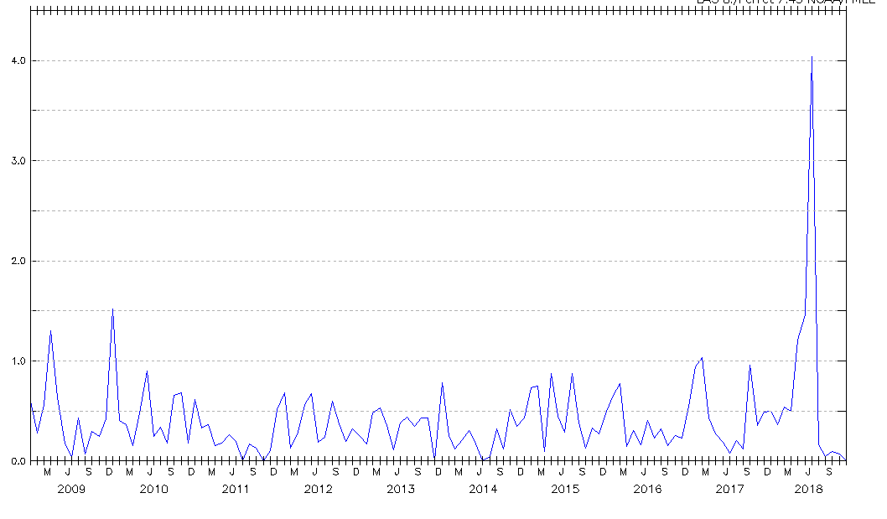
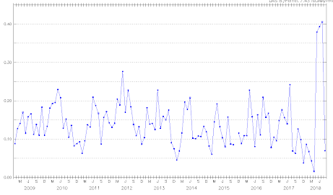
2008-2018, Hawaii
Monthly SO₂ Hawaii
Monthly Aerosols, Hawaii

Slide 28
Now switch graphs with the other group and compare.
Discuss the graphs with your group.
What are the similarities and differences among the aerosol and SO2 graphs?
What patterns do you see?
How might have the volcanic activity caused the pattern you observe?
How do you know that the volcano caused the change in aerosol or SO2?
Does the fact that the data showed _______ always happens (after/whenever) _____ occurs mean that ______ causes __________? Why/why not? Example.
What would you predict would happen if the volcanic activity would decrease. How would this affect SO2 values? aerosol values?

Slide 29
Make a Claim and Support With Evidence
Make a claim using SO2 data in relation to aerosols, volcanic eruptions, and safety.
What evidence do you have to support this claim?

Slide 30
Time to wrap up:
Share out claims and evidence with the class.

